Slide 1
Chap. 8 Central Processing Unit
Part 2

Slide 2
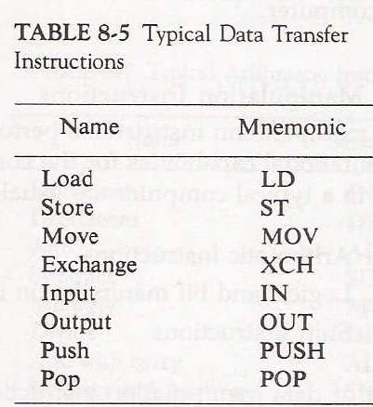
8-6 Data Transfer and Manipulation
  Most computer instructions can be classified into three categories:
    1) Data transfer, 2) Data manipulation, 3) Program control instructions
  Data Transfer Instruction
    Typical Data Transfer Instruction : Tab. 8-5
      Load : transfer from memory to a processor register, usually an AC (memory read)
      Store : transfer from a processor register into memory (memory write)
      Move : transfer from one register to another register
      Exchange : swap information between two registers or a register and a memory word
      Input/Output : transfer data among processor registers and input/output device
      Push/Pop : transfer data between processor registers and a memory stack

Slide 3
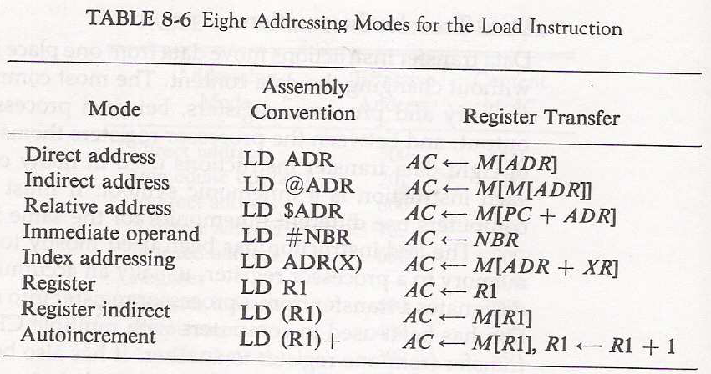
    8 Addressing Mode for the LOAD Instruction : Tab. 8-6
      @ : Indirect Address
      $ : Address relative to PC
      # : Immediate Mode
      ( ) : Index Mode, Register Indirect, Autoincrement 에서 register

Slide 4
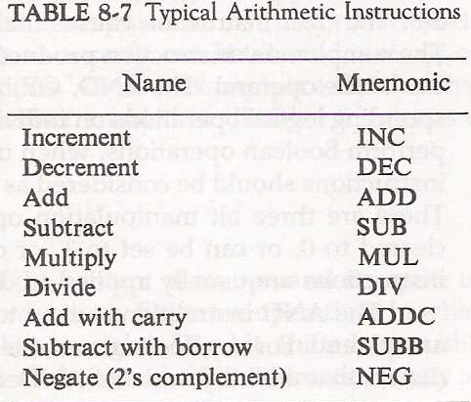
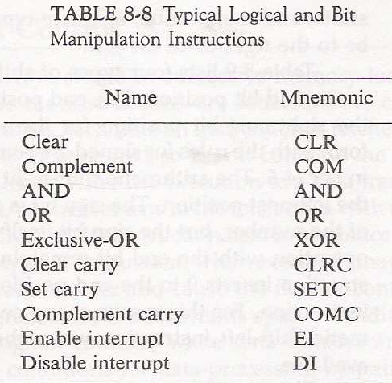
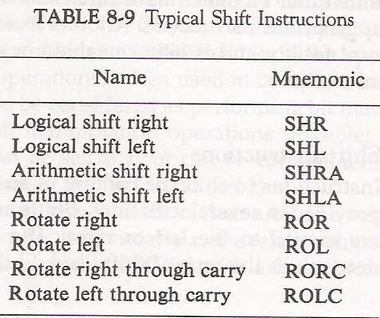
Data Transfer and Manipulation
  Data Manipulation Instruction
    Arithmetic Instructions : Tab. 8-7
    Logical and Bit Manipulation Instructions : Tab. 8-8
    Shift Instructions : Tab. 8-9

Slide 5
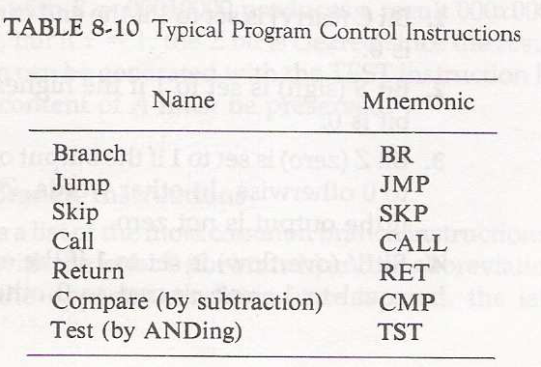
Program Control:
  Program Control Instructions specify conditions for altering the content of PC.
  The change in PC value as a result of the execution of program control instruction causes a break in the sequence of instruction execution.
  Program Control Instruction : Tab. 8-10

Slide 6
Program Control
  Program Control Instruction : Tab. 8-10
    Branch and Jump instructions are used interchangeably to mean the same thing
  Status Bit Conditions :
    Condition Code Bit or Flag Bit
      The bits are set or cleared as a result of an operation performed in the ALU
  4-bit status register
    Bit C (carry) : set to 1 if the end carry C₈ is 1
    Bit S (sign) : set to 1 if F₇ is 1
    Bit Z (zero) : set to 1 if the output of the ALU contains all 0’s
    Bit V (overflow) : set to 1 if the exclusive-OR of the last two carries (C₈ and C₇) is equal to 1
    Flag Example : A - B = A + ( 2’s Comp. Of B ) : A =11110000, B = 00010100
      11110000
      + 11101100 (2’s comp. of B)
      1 11011100
C = 1, S = 1, V = 0, Z = 0

Slide 7
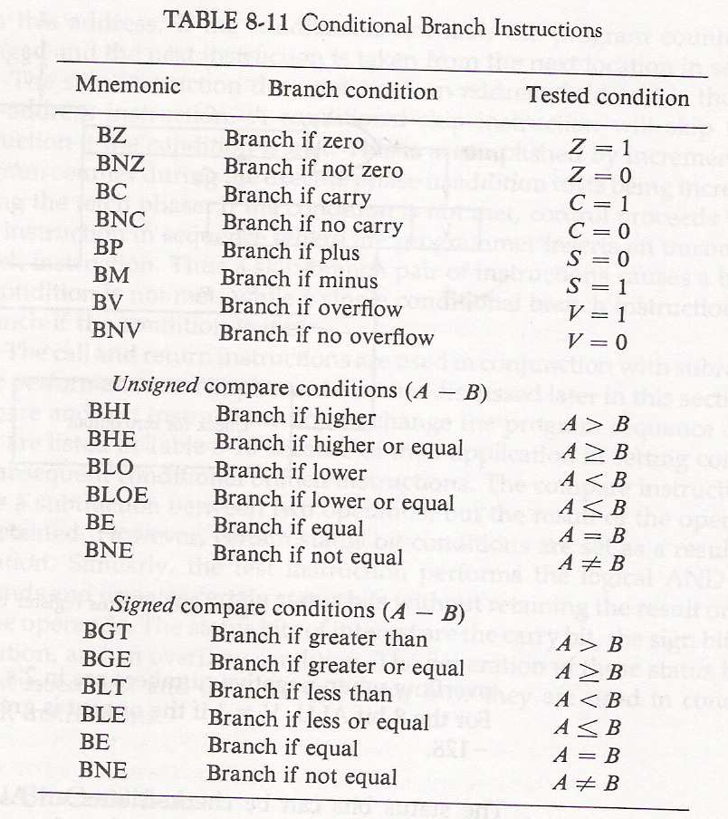
  Conditional Branch : Tab. 8-11

Slide 8
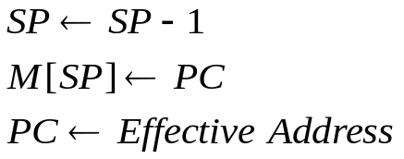
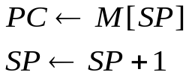
  Subroutine Call and Return
  Different computers use different temporary location to store return address :
    Use first memory location of the subroutine.
    Use a processor register
    Use a stack memory( the most efficient )
      CALL :
      RETURN
: Decrement stack point
: Push content of PC onto the stack
: Transfer control to the subroutine
: Pop stack and transfer to PC
: Increment stack pointer

Slide 9
  Program Interrupt
    Program Interrupt
      Transfer program control from a currently running program to another service program as a result of an external or internal generated request
      Control returns to the original program after the service program is executed
    Interrupt Service Program similar to Subroutine Call excepts that
      1) An interrupt is initiated by an internal or external signal (except for software interrupt)
        A subroutine call is initiated from the execution of an instruction (CALL)
      2) The address of the interrupt service program is determined by the hardware
        The address of the subroutine call is determined from the address field of an instruction
      3) An interrupt procedure stores all the information necessary to define the state of the CPU
        A subroutine call stores only the program counter (Return address)

Slide 10
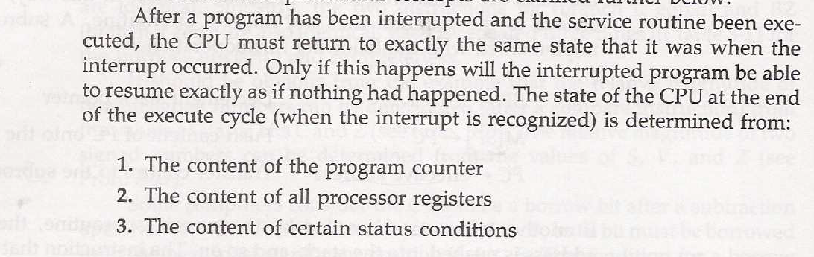

Slide 11
    Program Status Word (PSW)
      The collection of all status bit conditions in the CPU
      PSW stored in a separate hardware register and contains the status information that characterize the state of the CPU
    Two CPU Operating Modes
      Supervisor (System) Mode: (Privileged Instruction )
        When the CPU is executing a program that is part of the operating system
      User Mode : (User program)
        When the CPU is executing an user program

Slide 12
  Types of Interrupts
    1) External Interrupts
      come from I/O device, from a timing device, from a circuit monitoring the power supply, or from any other external source
    2) Internal Interrupts or TRAP
      caused by register overflow, attempt to divide by zero, an invalid operation code, stack overflow, and protection violation
    3) Software Interrupts
      initiated by executing an instruction.
      used by the programmer to initiate an interrupt procedure at any desired point in the program

Slide 13
8-8 Reduced Instruction Set Computer (RISC)
  RISC (Reduced Instruction Set Computing) and CISC (Complex Instruction Set Computing) are two computer architectures that are mainly used nowadays.
  The main difference between RISC and CISC is in the number of computing cycles each of their instructions take. With CISC, each instruction may utilize a much greater number of cycles before completion than in RISC.
  General differences are:
  CISC - larger, more feature-rich instruction set (more operations, addressing modes, etc.). slower clock speeds. fewer general purpose registers.
  RISC - smaller, simpler instruction set. faster clock speeds. more general purpose registers.

Slide 14
  Complex Instruction Set Computer (CISC)
    Major characteristics of a CISC architecture
      1) A large number of instructions - typically from 100 to 250 instruction
      2) Some instructions that perform specialized tasks and are used infrequently
      3) A large variety of addressing modes - typically from 5 to 20 different modes
      4) Variable-length instruction formats
      5) Instructions that manipulate operands in memory.
  Reduced Instruction Set Computer (RISC)
    Major characteristics of a RISC architecture
      1) Relatively few instructions
      2) Relatively few addressing modes
      3) Memory access limited to load and store instruction
      4) All operations done within the registers of the CPU
      5) Fixed-length, easily decoded instruction format
      6) Single-cycle instruction execution
      7) Hardwired rather than microprogrammed control

Slide 15
    Other characteristics of a RISC architecture
      1) A relatively large number of registers in the processor unit
      2) Use of overlapped register windows to speed-up procedure call and return
      4) Compiler support for efficient translation of high-level language programs into machine language programs
  Overlapped Register Windows
    Time consuming operations during procedure call
      Saving and restoring registers
      Passing of parameters and results
    Overlapped Register Windows
      Provide the passing of parameters and avoid the need for saving and restoring register values by hardware

Slide 16
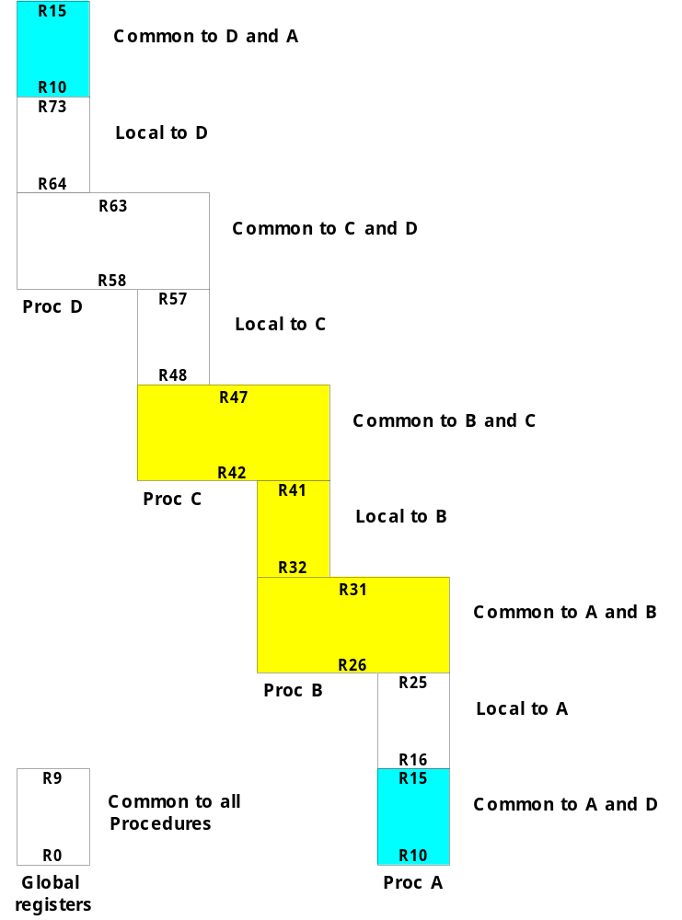
  Concept of overlapped register windows : Fig. 8-9
    Total 74 registers : R0 - R73
      R0 - R9 : Global registers
      R10 - R63 : 4 windows
        Window A
        Window B
        Window C
        Window D
    Example) Procedure A calls procedure B
      R26 - R31
        Store parameters for procedure B
        Store results of procedure B
      R16 - R25 : Local to procedure A
      R32 - R41 : Local to procedure B
10 Local registers
+
2 sets of 6 registers
(common to adjacent windows)
Circular Window

Slide 17
  The organization of register windows will have the following relationships:
    G : Global registers.
    L : Local registers.
    C : Common registers
    W : Number of windows.
    The number of register available for each window is calculated as follow :
    Window Size= L + 2C + G
    The total number of register needed in the processor is
    Register file= (L+C)W+ G
    Example shown on the previous figure:
        G = 10, L = 10, C = 6, W = 4
      Window Size → L + 2C + G = 10 + ( 2 * 6 ) + 10 = 32 registers
      Register File (total register) → (L + C) * W + G = (10 + 6 ) * 4 + 10 = 74 registers

